Slide 1
Positive Changes
Introduction of more democratic regimes,
liberalizing economies to develop capital markets.
Strengthened Telecommunication networks
Growing cross-regional trade
Growing infrastructure development demand
A rising middle class driving Retail sector
The criteria of private sector-led growth, and investable markets were met in Botswana, Ghana, Kenya, Mozambique, Nigeria, Tanzania, Uganda and Zambia
African markets overall outperformed the world averages last year.
Furthermore, it has an enormous coastline and is more proximate to both European and North American markets than Asia is.

Slide 2
Stock Market and Economic Growth
Sub Saharan Africa

Slide 3
Stock Market
Among Individuals :
Encourage savings by providing individuals with an additional financial instrument that may better meet their risk preferences and liquidity needs.
Among Firms:
Avenue to raise capital at lower cost.
Help companies less dependent on bank financing, which can reduce the risk of a credit crunch.( Firm Financing )

Slide 4
Prior to 1989 -> 5 stock markets Today -> 19 stock exchanges ranging
Botswana
Botswana Stock Exchange
Botswana Market listing
Ghana
Ghana Stock Exchange
Kenya
Africa Online - Kenya
Nairobi Stock Exchange
Malawi
Malawi SE & market listing
Mauritius
Stock Exchange of Mauritius (SEM)
Mozambique
Maputo Stock Exchange (Mozambique)
Namibia
Namibian Stock Exchange (NSX) -
Namibian Stock Exchange
Nigeria
Lagos Stock Exchange (Nigeria) -
Nigerian Stock Exchange
Swaziland
Swaziland Stock Market
South Africa
Financial Services Board
Johannesburg Stock Exchange(JSE)
Johannesburg Stock Exchange
South African Futures Exchange
Tanzania
Dar es Salaam Stock Exchange (Tanzania)
Uganda
The Uganda Securities Exchange
Zambia
Lusaka Stock Exchange (LuSE), Zambia -
Lusaka Stock Exchange
Zimbabwe
Zimbabwe Stock Exchange

Slide 5
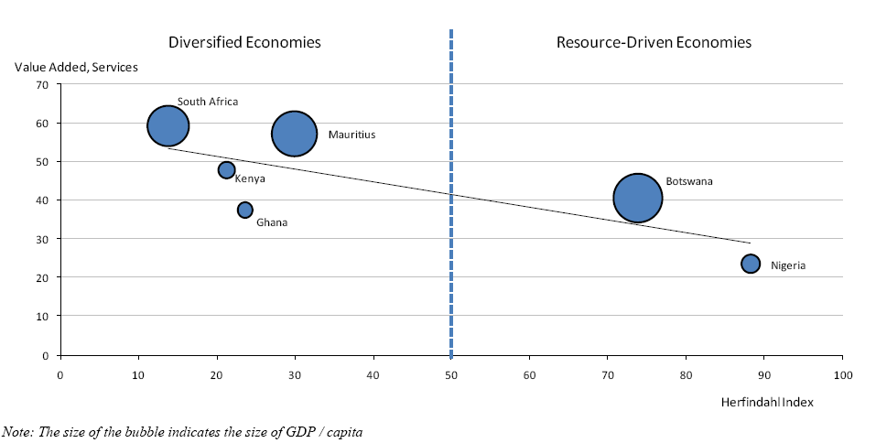
TRENDS AND CHARACTERISTICS
Top SSA countries and their stock markets
I) Botswana,
II) Ghana,
III) Kenya,
IV) Mauritius, V) Nigeria
(data source:WB (World Bank, 2011),

Slide 6
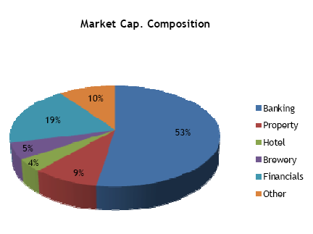
Botswana
high economic growth rates
a middle-income country
fiscal discipline and sound management
Services contributing to GDP
Banks, insurance and business services, government services, and hotels and restaurants
government, quasi-government and the private sector can raise debt and equity capital.
BSE is one of Africa's best performing stock exchanges
Botswana Stock Exchange-> operate and regulate the equities and fixed interest securities market

Slide 7
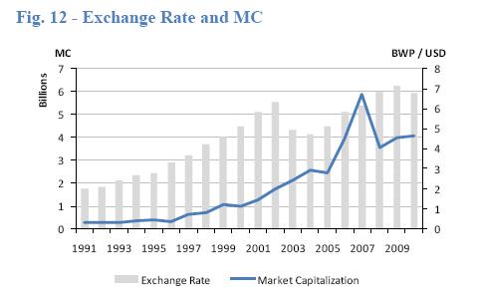
Botswana - Business environment
a liberalized exchange rate
a low tax burden on private business
In the WB's 2010 Doing Business report, Botswana ranked 45th out of 183 countries, the third highest ranking in
Africa after Mauritius (17th) and South Africa (34th).
strong potential to attract portfolio investment and foreign direct investment (FDI)

Slide 8
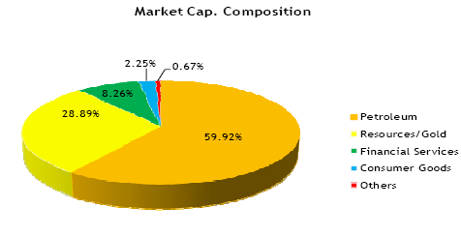
Ghana
A major exporter of natural resources
Gold and cocoa production and individual remittances are major sources of foreign exchange (World Bank., 2010)
Prudent macroeconomic management along with high prices for gold and cocoa helped sustain GDP growth in 2008-10
Ghana Stock Exchange (GSE) was incorporated in July 1989 and trading commencing in 1990.
automated trading system
30 listed companies
All types of securities can be listed on the GSE.
The criteria for listing include capital adequacy, profitability, spread of shares, years of existence and management efficiency

Slide 9
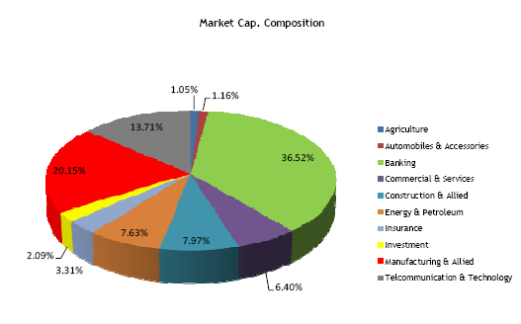
Kenya
a regional hub for trade and finance in East Africa
Agriculture accounts for about 1/4 of the GDP
building and construction sectors have been important contributors
Nairobi Securities(Stock) Exchange was constituted in 1954 (NSE)

Slide 10
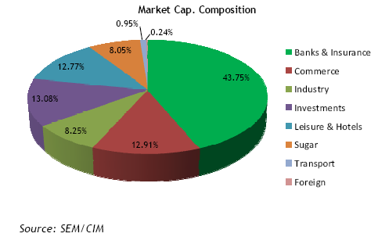
Mauritious
stable democracy, regular free elections
a positive human rights record, equal income distribution, increased life expectancy, lower infant mortality, an improved infrastructure, high per capita incomes, Strong International reserves
Domestic banks are profitable, well capitalised and liquid
Fish processing, information and communications technology (ICT) and property development are upcoming sectors
sound economic policies and prudent banking practices
Stock Exchange of Mauritius (SEM)-> privately-owned with a public mandate giving it the responsibility of operating and promoting an efficient, liquid, fair,transparent and regulated securities market in Mauritius
Stock Exchange of Mauritius Automated Trading System (SEMATS), which is an online trading system accommodating both common stocks and debt instruments
2010 WB Doing Business indicators, Mauritius was ranked 17 out of 183 countries

Slide 11
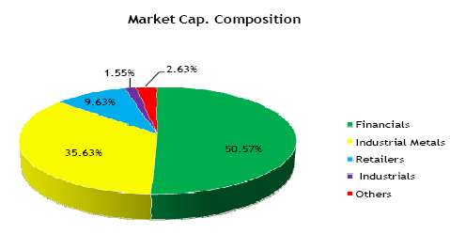
Nigeria
SSA's second largest economy
Heavily dependent on oil and gas (7th largest oil exporter in the world )
Nigeria's foreign trade is dominated by oil which accounts for 95% of the total foreign exchange income (Bloomberg, 2011).
Agriculture another contributor
Arbitrarily applied regulations and pervasive corruption
The Nigerian Stock Exchange services the second largest financial market in SSA
marketplace for trading investment instruments
attractive investment destination for emerging market investments
Offer a broad range of equities, indices, derivatives, market data and financial information (ASEA, 2011)
The USA is Nigeria's main trading partner,
purchasing 35% of Nigeria's oil exports. China is the leading source (14%) of Nigerian imports

Slide 12
Caution!!
Less developed than other emerging equity markets.
Few stocks which account for a considerable part of the total market capitalization.
Serious informational and disclosure deficiencies.
Inadequate supervision by regulatory authorities.
Risk due to
illiquidity of markets,
inflation,
currency fluctuations
political risk

Slide 13
Mutual Funds & ETF

Slide 14
Fund Name | Ticker | Sub-Saharan Weight (excluding South Africa, Mining, and Oil) | Frontier African Countries Represented
Nile Pan Africa Fund | NAFAX | 25.1% | Nigeria, Ghana
Wasatch Frontier Emerging Small Countries Fund | WAFMX | 23.9% | Nigeria, Kenya, Ghana, Namibia
Market Vectors Africa Index ETF | AFK | 20.8% | Nigeria, Kenya
Templeton Frontier Markets | TFMAX | 18.9% | Nigeria, Kenya, Zimbabwe, Mauritius, Ghana, Malawi
HSBC Frontier Markets Fund | HSFAX | 17.5% | Nigeria, Kenya
iShares MSCI Frontier 100 Index Fund | FM | 15.5% | Nigeria, Kenya, Mauritius
Harding Loevner Frontier Emerging Markets Portfolio | HLMOX | 13.8% | Nigeria, Kenya, Ghana, Mauritius, Senegal
T. Rowe Price Africa & Middle East | TRAMX | 10.7% | Nigeria, Ghana, Zambia
Commonwealth Africa Fund | CAFRX | 4.0% | Nigeria, Kenya
iShares MSCI South Africa Index | EZA | 0.0%
SPDR S&P Emerging Middle East and Africa | GAF | 0.0%

Slide 15
AFK - Market Vectors Africa ETF
Follows the Dow Jones Africa Titans 50 Index, which focuses on companies that are located in Africa, are listed on the African Stock Exchange, or conduct 50% of their business in the region.
The Index comprises a diversified group of 50 companies.
Companies eligible for inclusion in Index should be headquartered or generating majority of revenues in Africa with market cap exceeding $200 million; should have three-month average daily turnover greater than $1 million, and should be traded on domestic or international stock exchanges.
The Fund is passively managed and may not hold each Index component in the same weighting as the Index
Along with equities, AFK also uses derivatives such as forwards, futures, swaps and option that help track the correlating index.
Some of the top holdings in the fund are Nigerean Breweries, Tullow Oil, Attijariwafa Bank and Orascom Construction.
59.2% Sub Saharan Africa weight/exposure
43.1% Sub Saharan Africa weight/exposure(excluding oil/mining companies)

Slide 16
EZA - iShares MSCI South Africa Index ETF
100% Sub Saharan Africa weight/exposure
73.6% Sub Saharan Africa weight/exposure(excluding oil/mining companies)
EZA targets the South Africa by tracking the MSCI South Africa Index.
Targets publicly traded securities in the South African equity market.
Top holdings -> MTN Group, Sasol LTD and Naspers LTD.
Top sectors -> Financials, Materials, Telecommunications and Consumer Discretionary.

Slide 17
GAF - SPDR S&P Emerging Middle East & Africa ETF(Fund)
seeks to replicate ->the total return performance of the S&P/Citigroup BMI Middle East & Africa Index (the Index).
Market capitalization-weighted index -> defines and measures -> investable publicly traded companies domiciled in emerging Middle Eastern and African markets
Index is float adjusted, meaning that only those shares publicly available to investors are included in the Index calculation.
The Fund uses a passive management strategy designed to track the price and yield performance of the Index.
91.3% Sub Saharan Africa weight/exposure
68.2% Sub Saharan Africa weight/exposure(excluding oil/mining companies)
Top holdings -> Anglo gold, Impala Platinum.
Top sectors represented -> Financials, Materials, Telecommunications and Consumer Discretionary.

Slide 18
Focus on Private equity
Typically provide capital for Growing Firms
Two types: Financial leveraging; value creation through active ownership ->latter more prevalent in SSA
PE investors + Investee Firms aligned to longer time horizon -> 5-10 years
South African
institutional investors -> Government Employee pension fund
State owned Electricity utility-> ESKOM
GEPF

Slide 19
Investing in US Mutual Fund-> Africa
http://investinginafrica.net/2012/11/11-african-mutual-funds/
http://www.imara.co/uploads/stockbroking/africa-securities/IAS_SSA_2011_Review_and_2012_Outlook_10_Feb_2012.pdf
http://seekingalpha.com/article/291837-an-africa-focused-mutual-fund-versus-2-index-etfs-a-matter-of-less-risk
http://etf.about.com/od/foreignetfs/a/Invest-In-Africa-With-These-African-Etfs.htm
http://seekingalpha.com/article/291837-an-africa-focused-mutual-fund-versus-2-index-etfs-a-matter-of-less-risk

